Slide 1
﻿Optimizing Bit-Serial Matrix Multiplication for Reconfigurable Computing
﻿YAMAN UMUROGLU, Xilinx Research Labs, Ireland
DAVIDE CONFICCONI, Xilinx Research Labs, Ireland and Politecnico di Milano, Italy
LAHIRU RASNAYAKE, Norwegian University of Science and Technology, Norway
THOMAS B. PREUSSER, Accemic Technologies GmbH, Germany
MAGNUS SJÄLANDER, Uppsala University, Sweden and Norwegian University of Science and Technology, Norway Matrix-matrix

Slide 2
1.Introduction
The disadvantage of fixed precision:
﻿the associated overhead in storing, communicating, and performing operations with full precision when an application only requires a fraction of the supported precision.
﻿fixed-precision accelerators are not suitable for applications with variable precision
BISMO(﻿bit-serial matrix multiplication overlay):
﻿a software-programmable weighted binary matrix multiplication engine
﻿associated hardware for fetching data and storing back the result
The advantage of BISMO:
﻿the hardware architecture is design-time configurable
﻿operate on any matrix size and at any fixed-point or integer precision

Slide 3
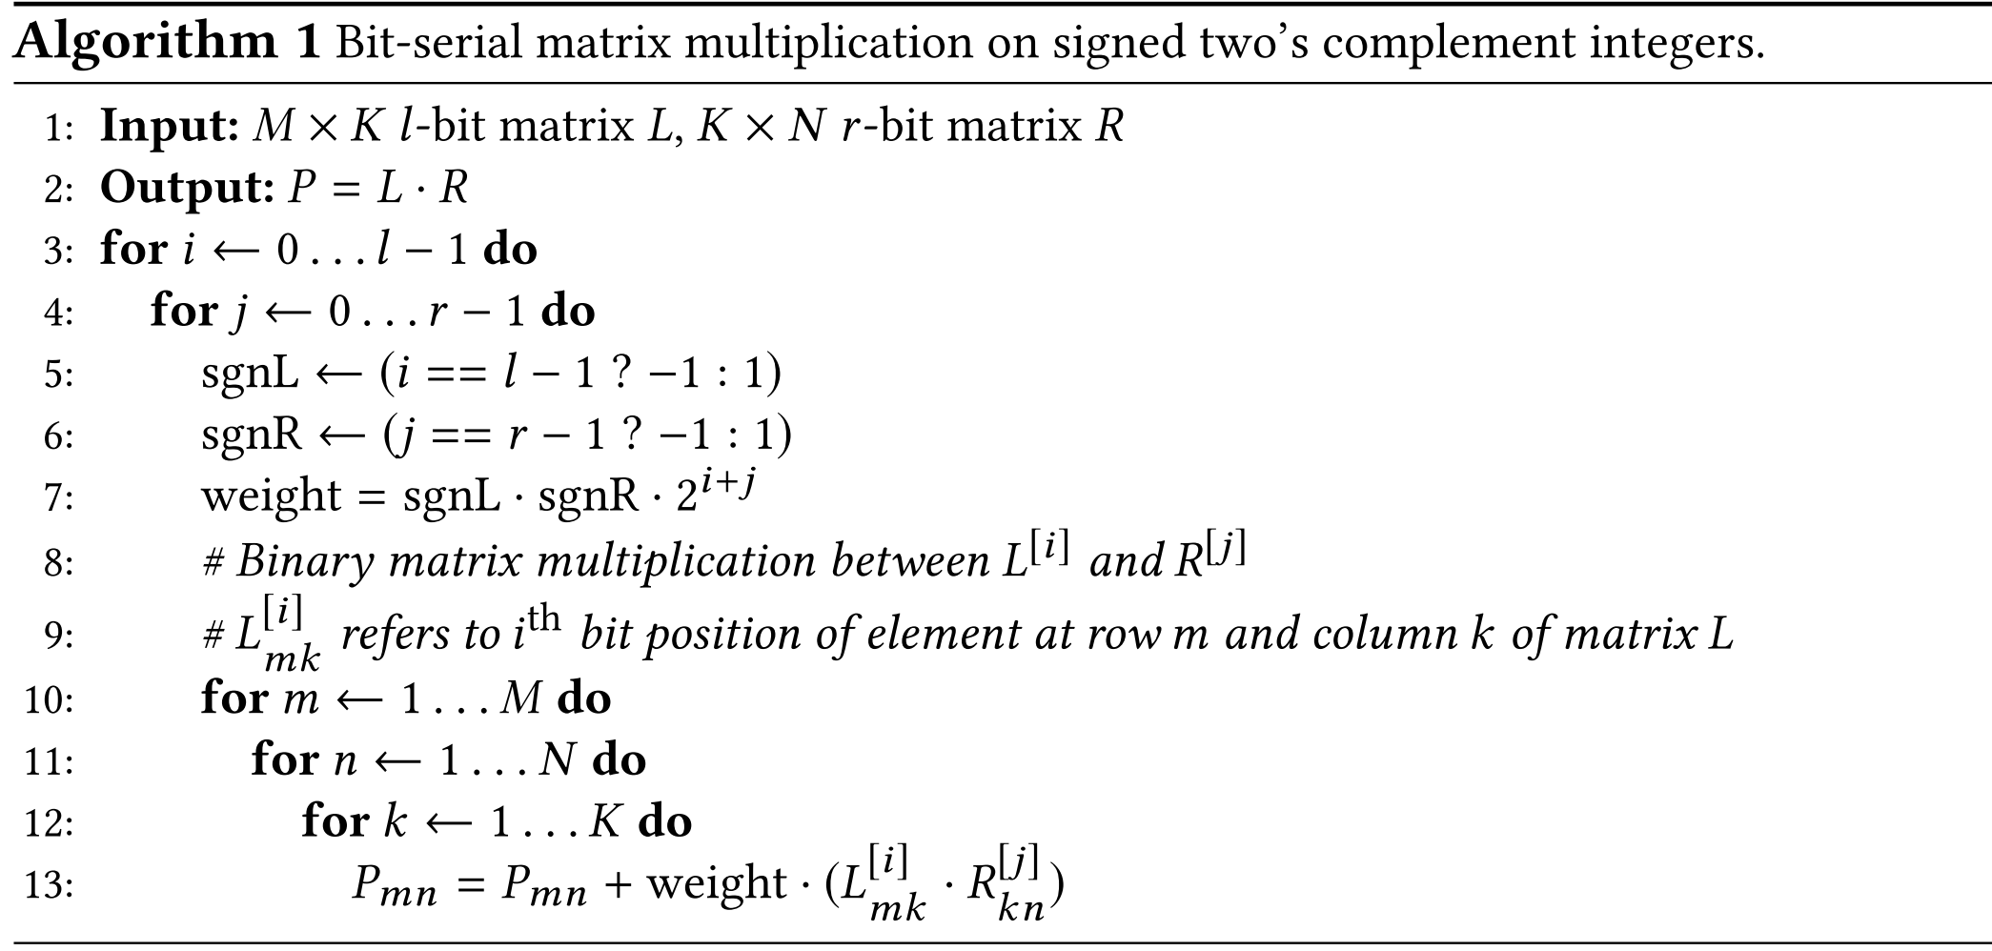
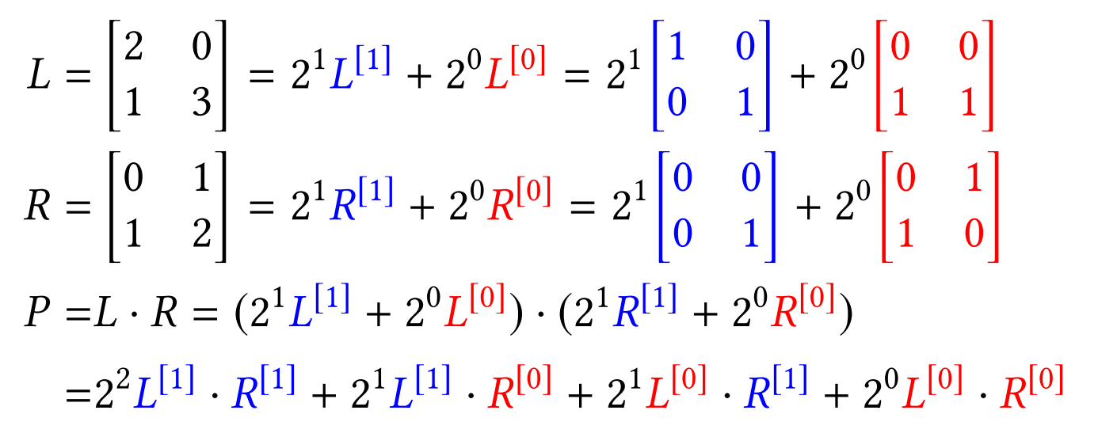
2.Background: bit-serial
﻿expressing a matrix multiplication as a weighted sum of binary matrix multiplications to efficiently compute matrix multiplications of variable precision.
﻿If the input matrices are provided in bit-parallel format, they should first be converted into a bit-serial layout to ensure performance.

Slide 4
3. ﻿BISMO
﻿Precision Scalability: ﻿the same hardware can be utilized for a range of different precisions
﻿Hardware Scalability: ﻿scale the memory and compute resource utilization to match system-level requirements.
﻿Software Programmability: ﻿hardware architecture is software-programmable at the granularity of instructions

Slide 5
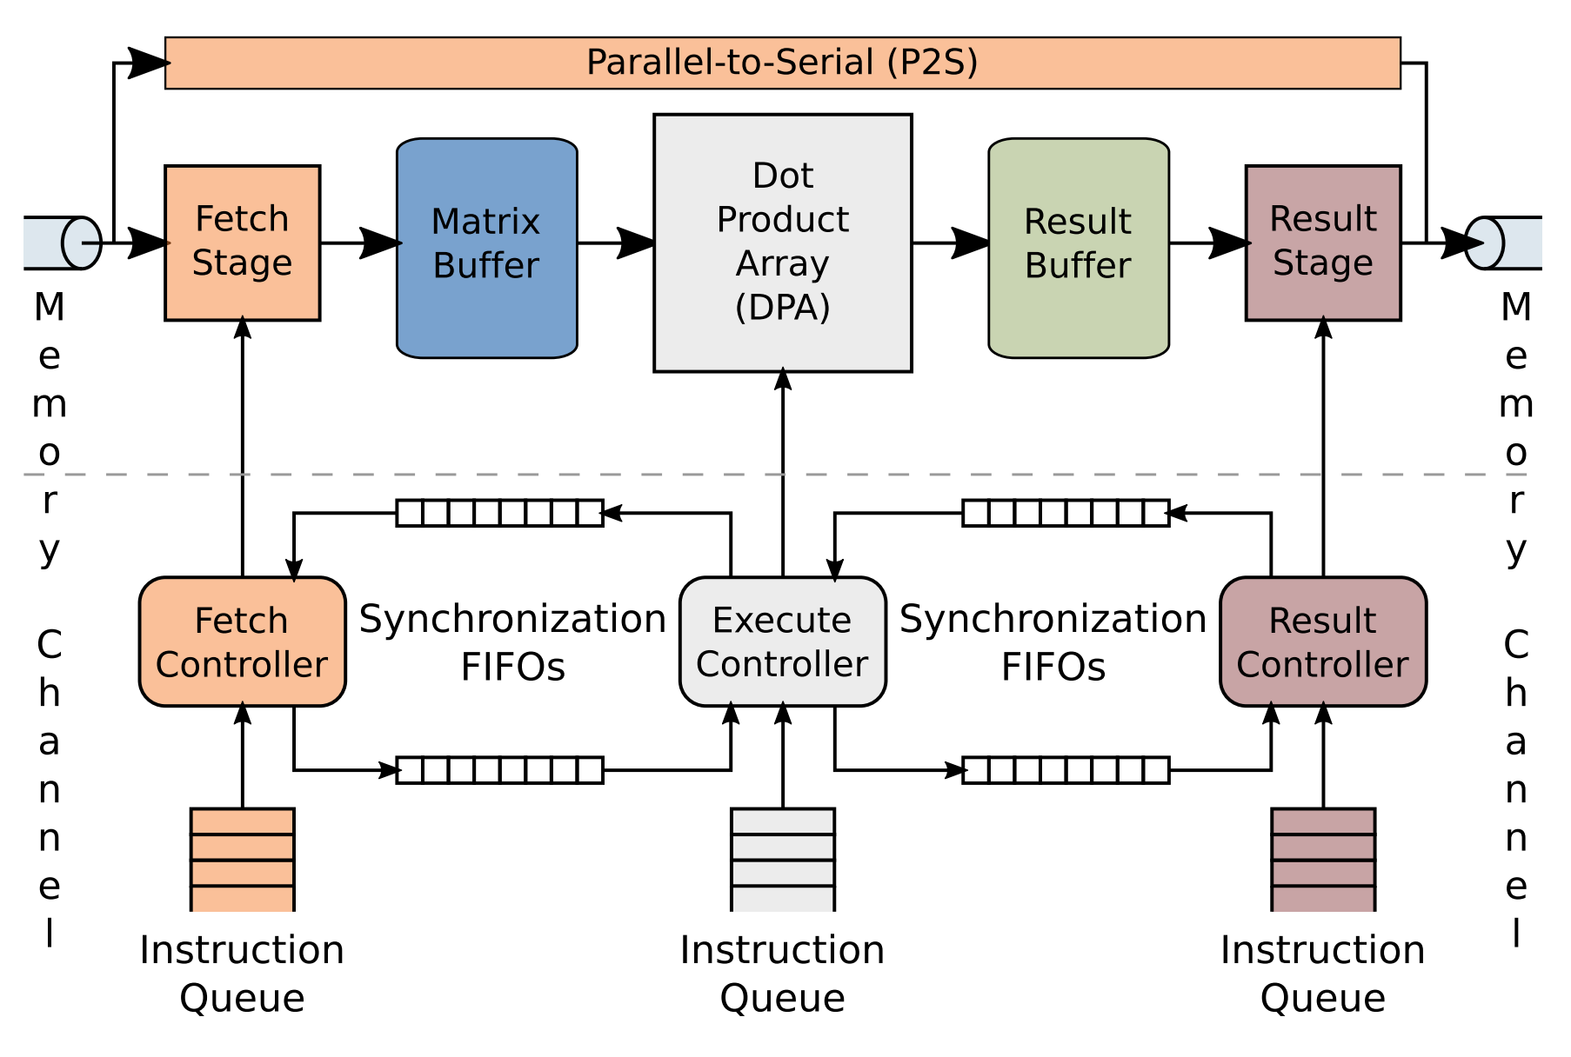
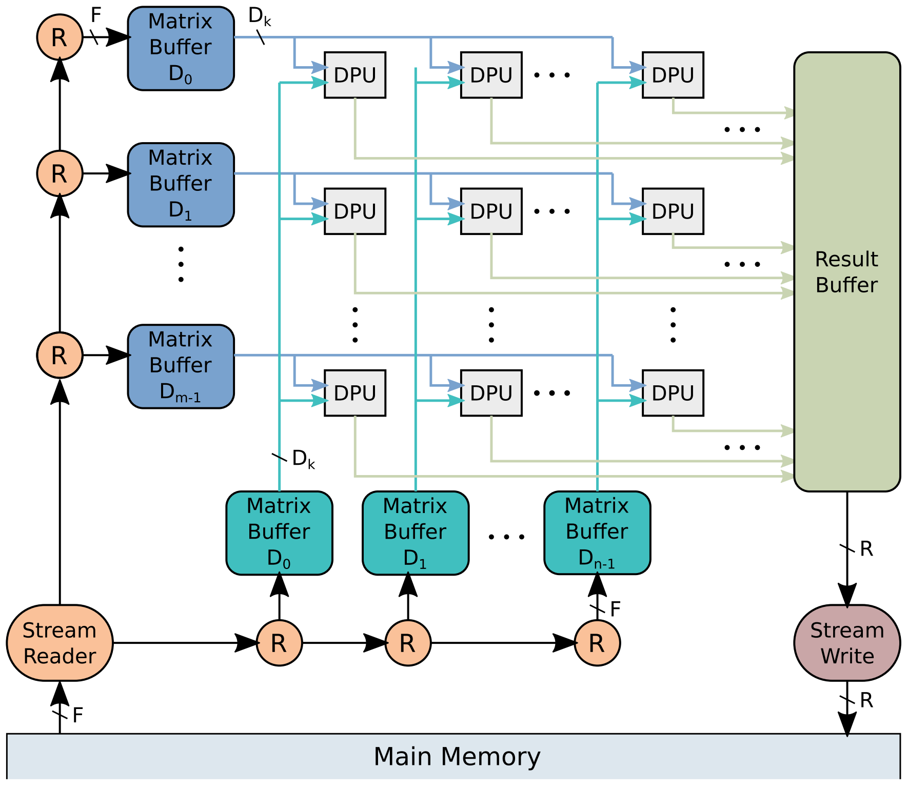
3. ﻿﻿Hardware Architecture Overview
﻿ ﻿The architecture is organized into three pipeline stages: fetch, execute, and result. Each stage communicates data to the next stage via shared on-chip memory buffers. Inter-stage synchronization is achieved by blocking reads and writes to synchronization FIFOs.

Slide 6
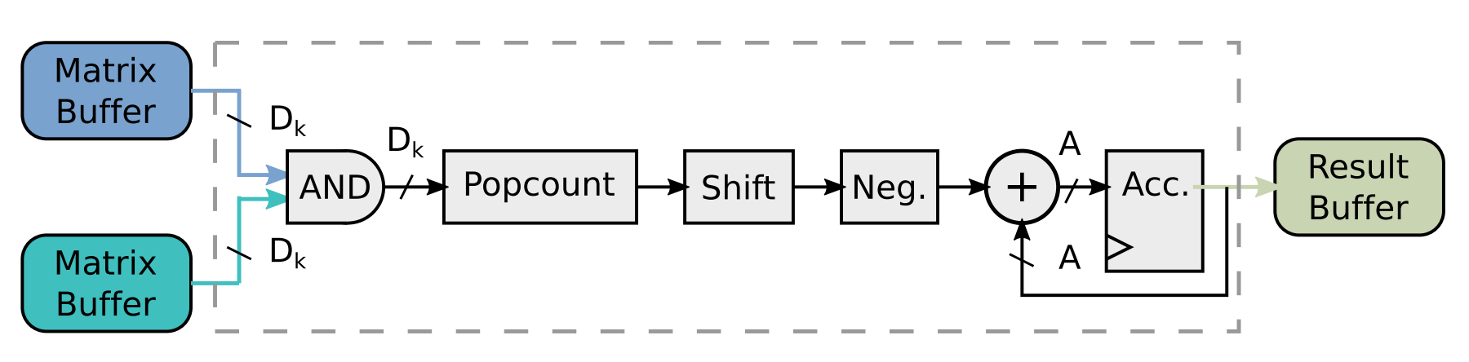
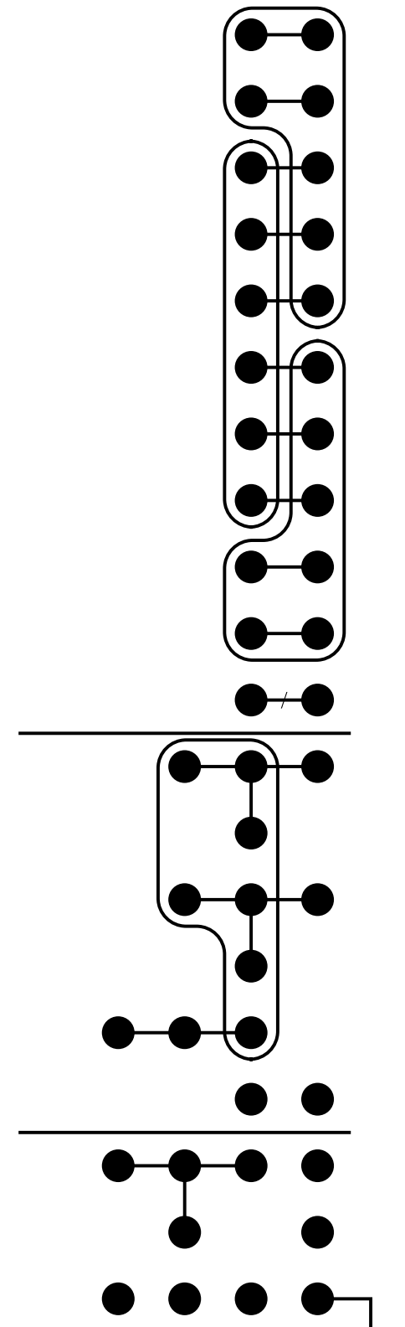
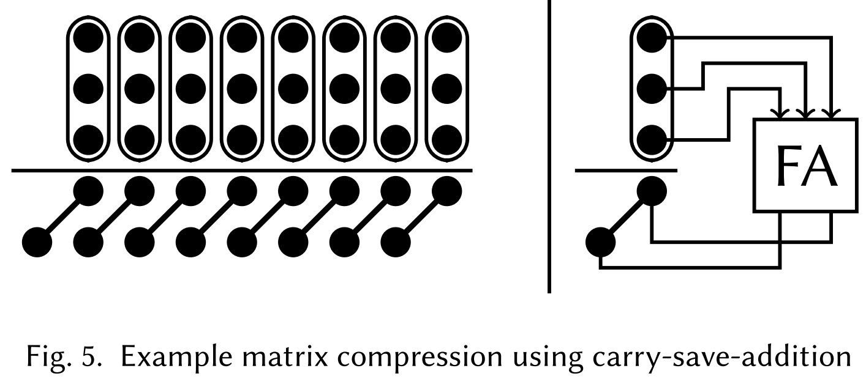
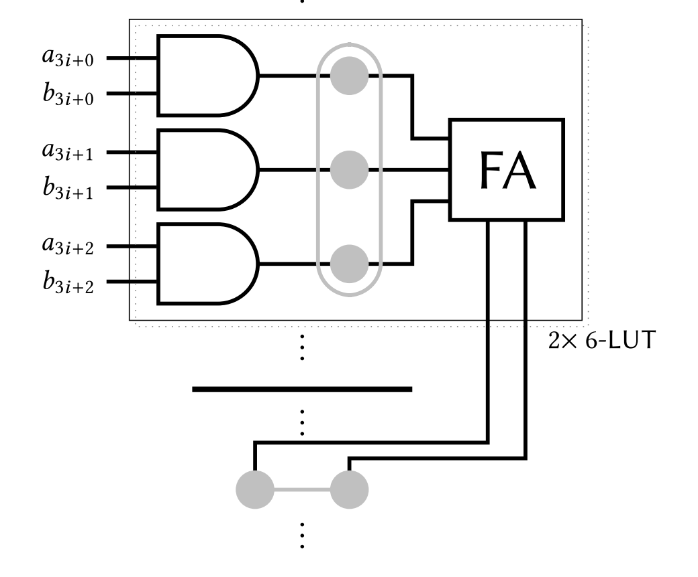
﻿The Dot Product Unit
Original DPU
﻿Efficient And-Popcount for Xilinx FPGAs.

Slide 7
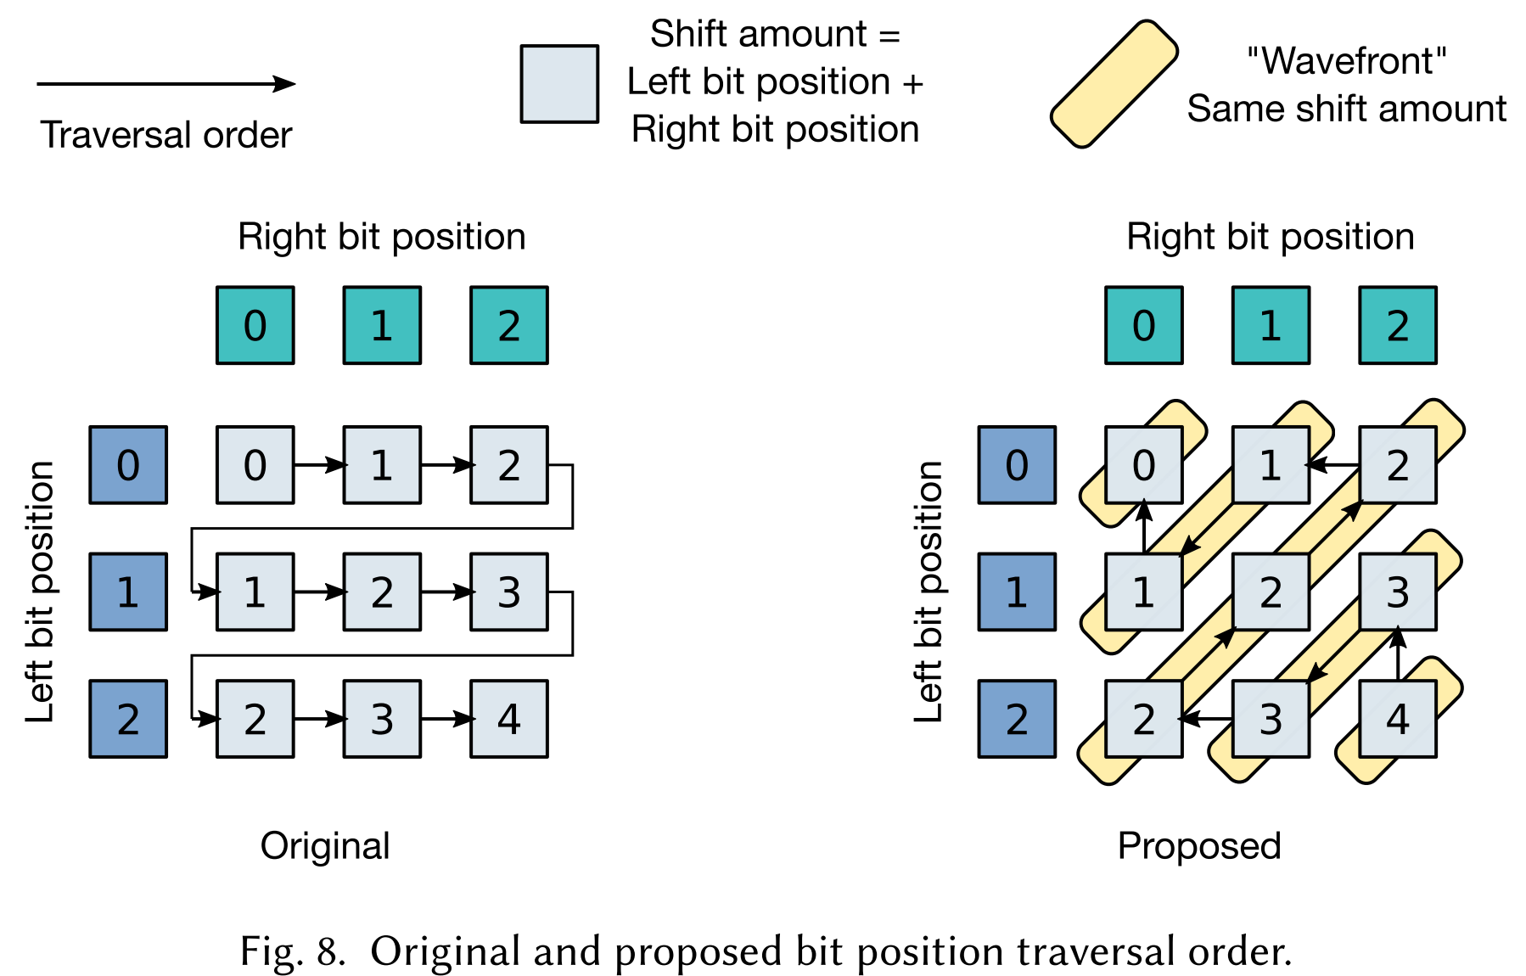
﻿The Dot Product Unit
﻿Improved DPU
﻿the sum of L and R bit positions constitute wavefronts, where each wavefront has a left-shift value that is one less than the previous one. ﻿The barrel shifter is replaced with a constant one-left-shift.

Slide 8
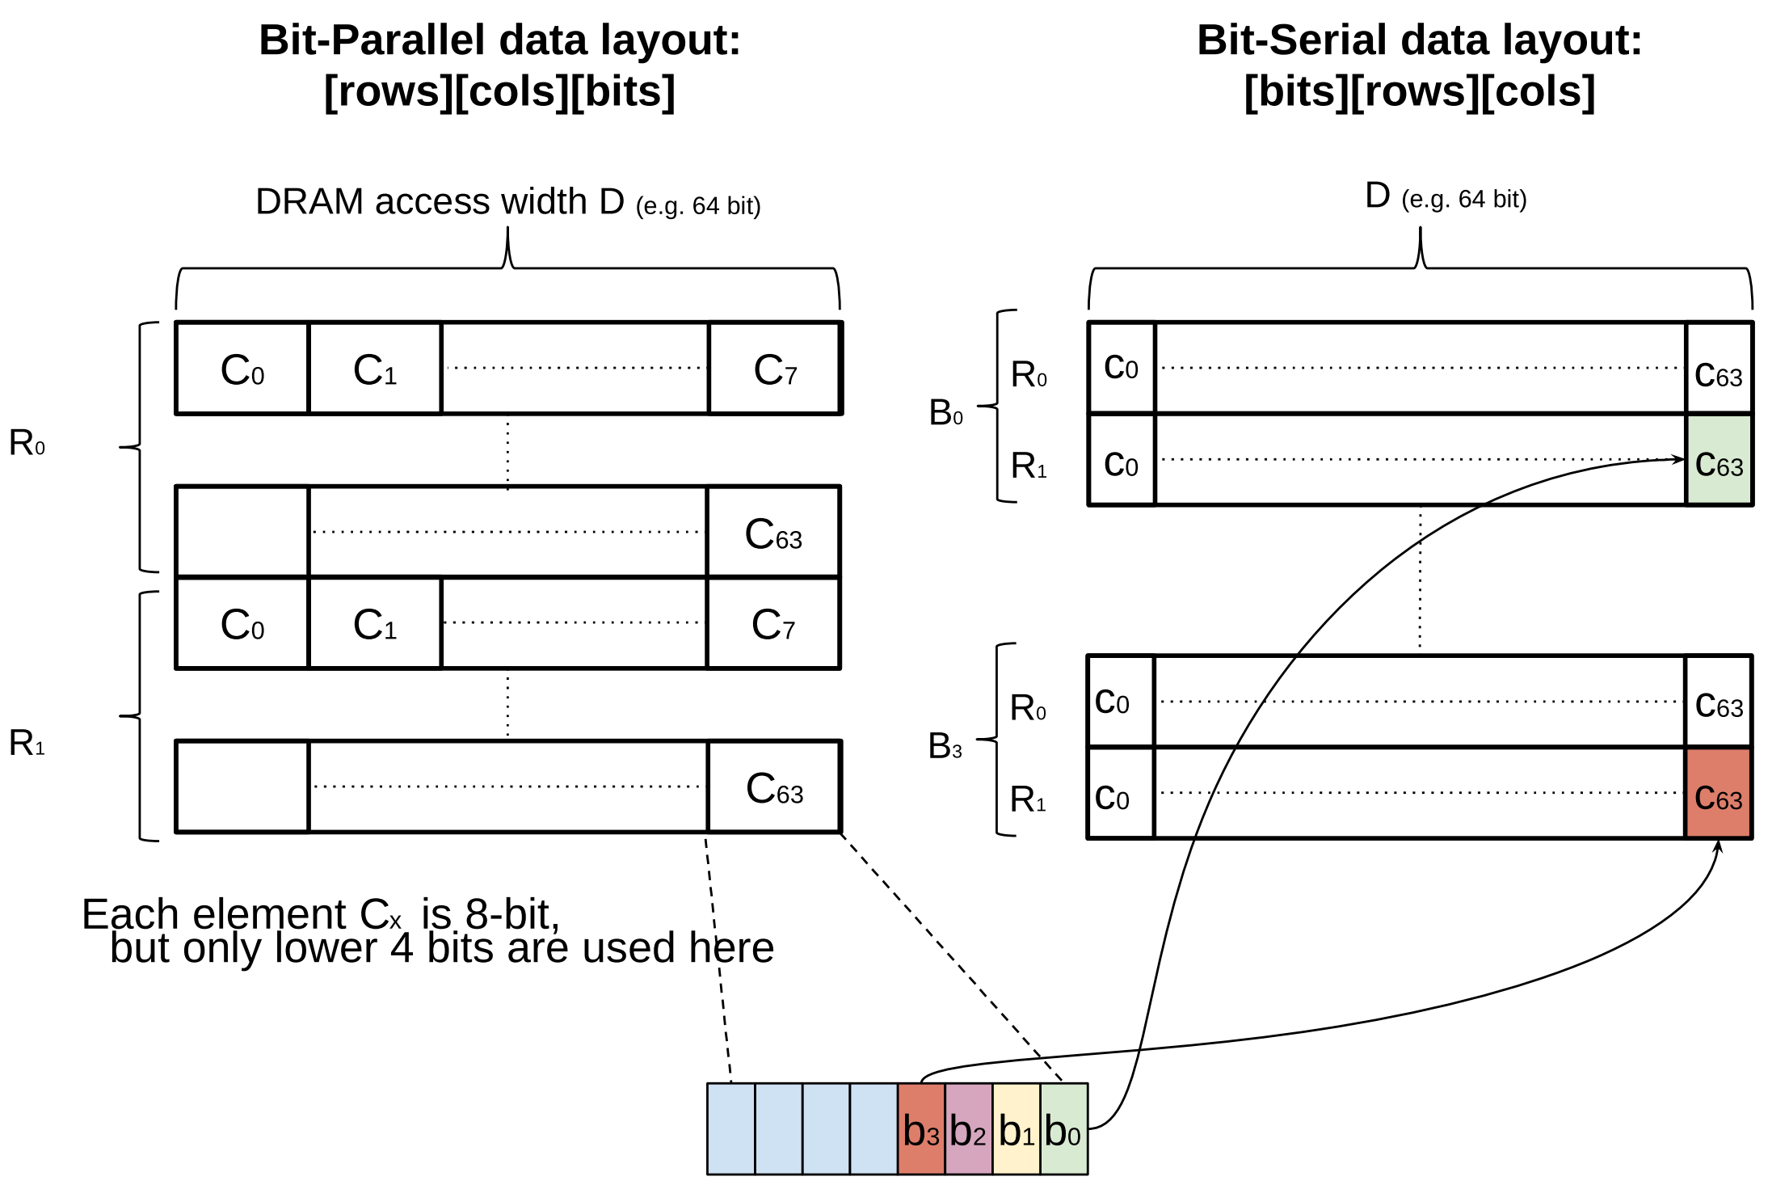
﻿Bit-Parallel to Bit-Serial Matrix Transformation

Slide 9
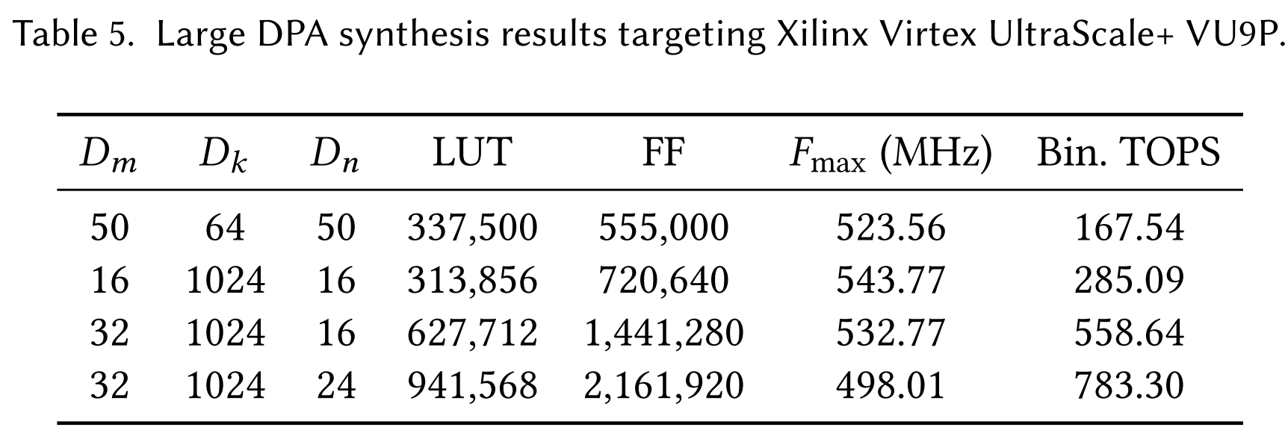
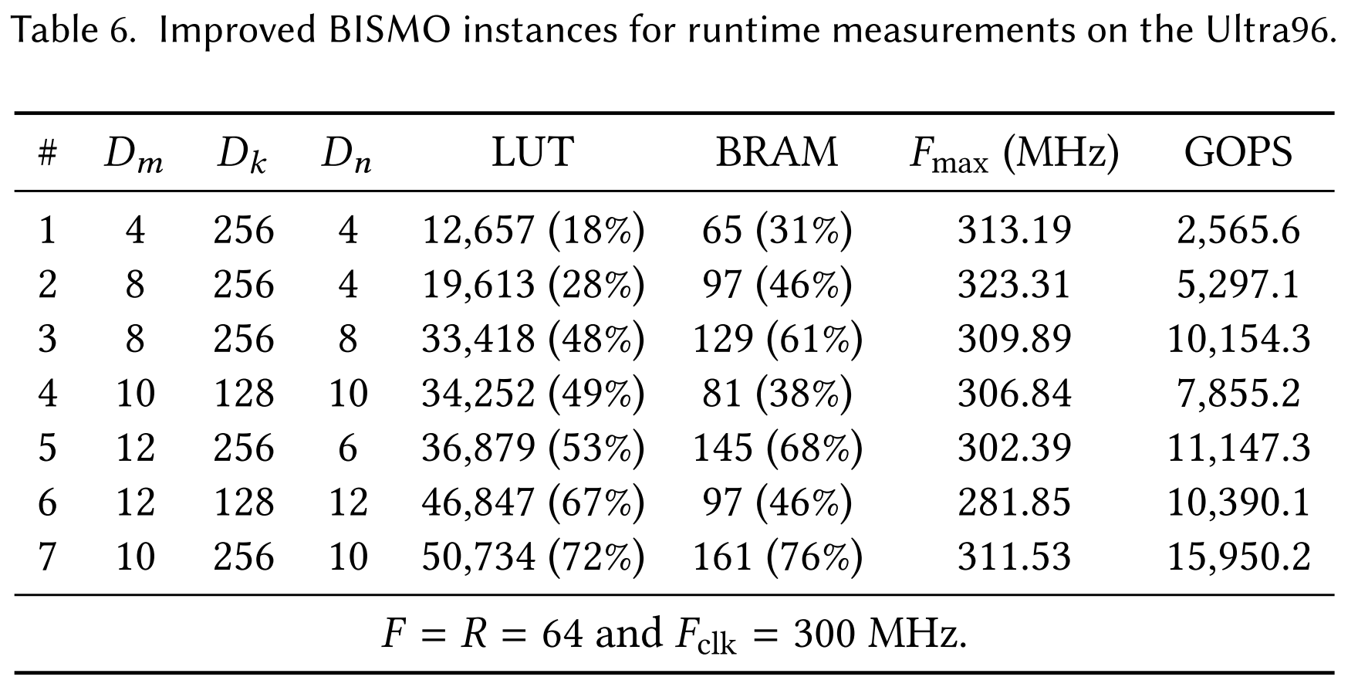
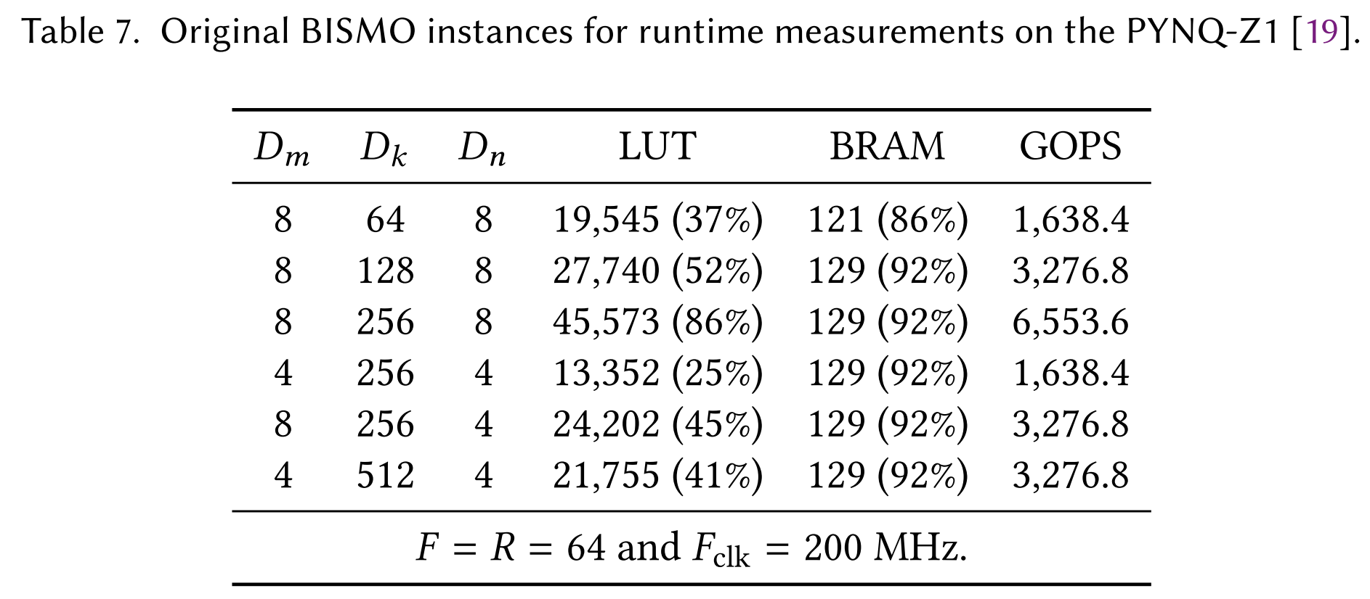
Evaluation
﻿Scaling the BISMO DPA to Larger Sizes
Runtime performance

Slide 10
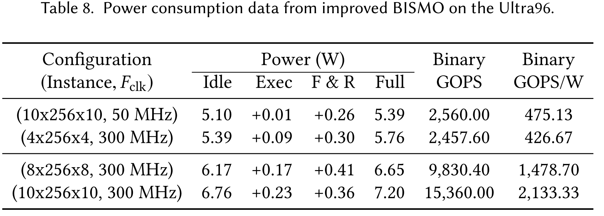
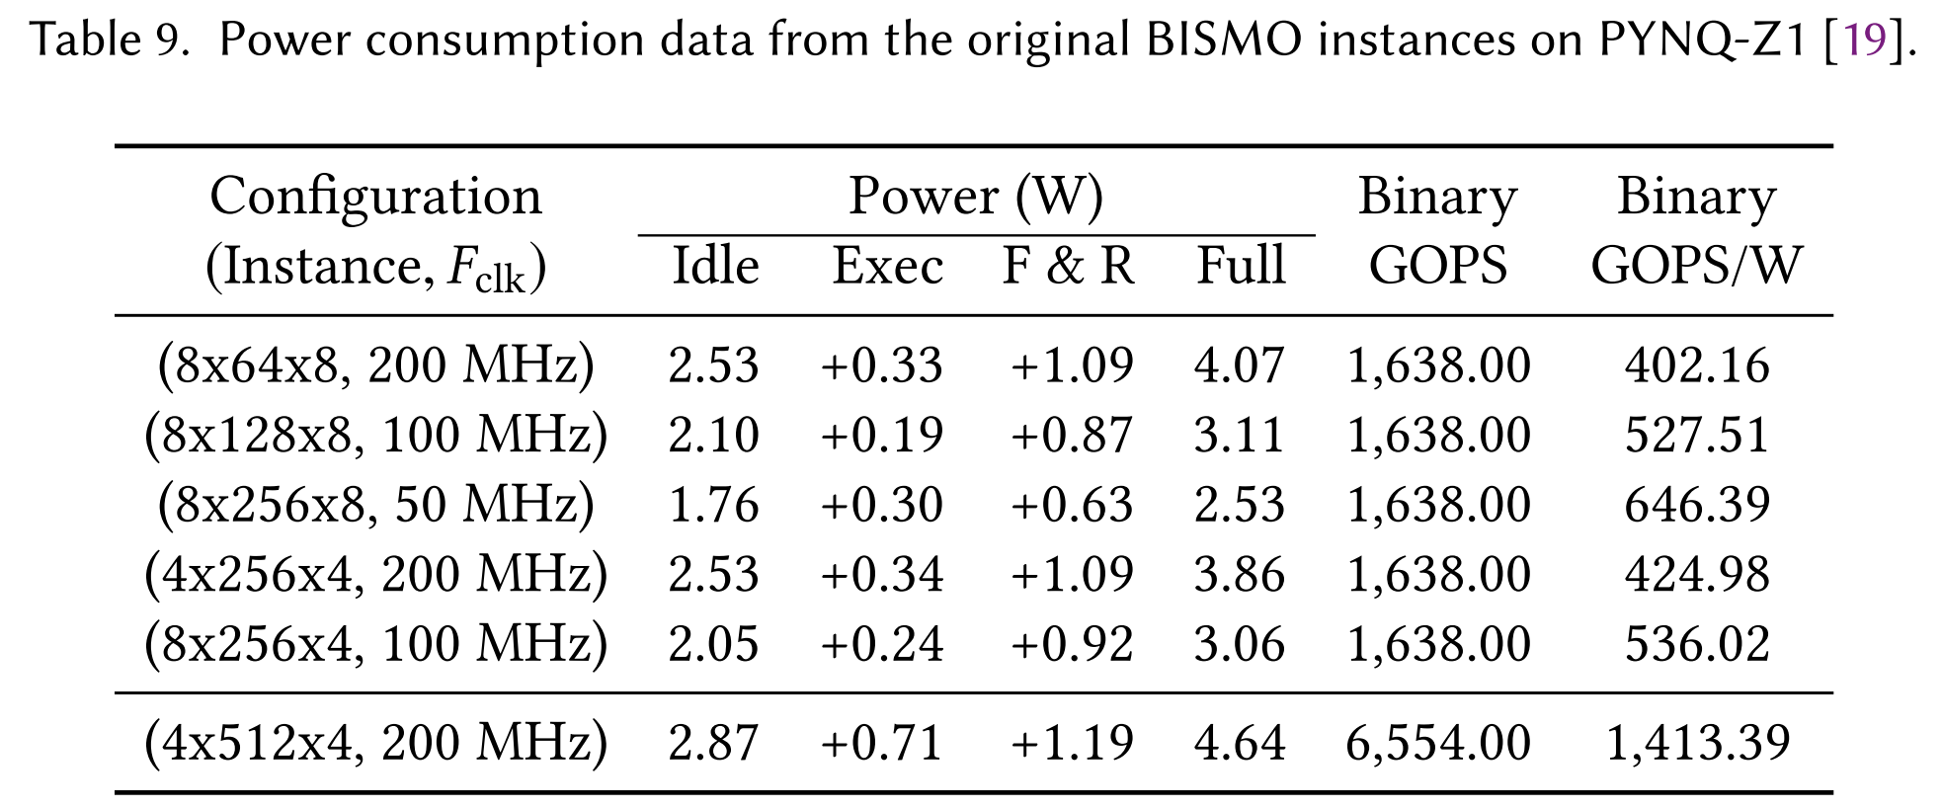
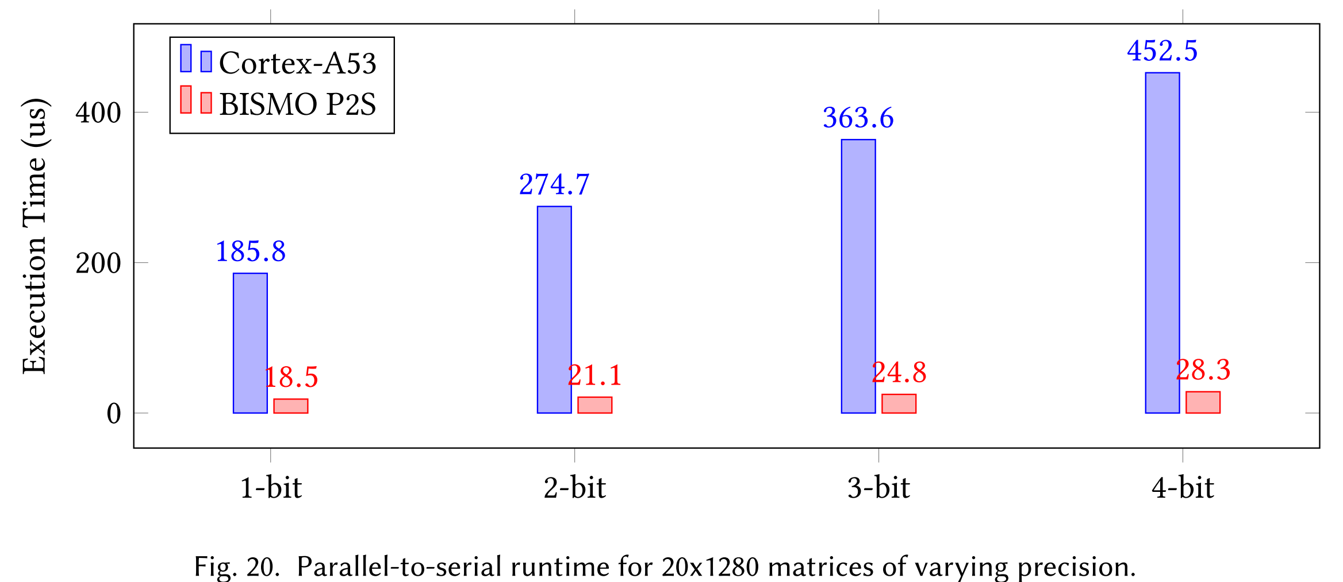
Evaluation
﻿Power consumption
﻿Parallel-to-Serial Accelerator Performance

